Slide 1


Monthly Long-Short Trading Strategy
This strategy backtests a momentum-based approach from 2010 to 2023.
It rebalances positions monthly to simulate capital growth systematically.
by Chandan Sah

Slide 2

Strategy Initialization
Inputs
Data Loading
Start/end dates, initial capital, rebalancing timing.
Reads stock price data from Prices.csv file.
Portfolio Setup
Initializes trades, cash balance, and positions state.

Slide 3
Data Structures for Simulation
Price Data
Trade Records
Positions
Historical stock prices stored as a time series.
Keeps detailed logs of buy/sell activity daily.
Number of shares per stock each day
Value of holdings and cash per day
Long/short flags indicating position direction

Slide 4

Core Backtest Engine
1
Daily Loop
2
Rebalancing
Iterate through each trading day sequentially.
Adjust portfolio only on month-end dates.
3
Position Updates
Carry positions forward on non-rebalance days.

Slide 5




Momentum Signal Logic
Calculate Returns
Use 12-month return ending one month prior to rebalance.
Rank Stocks
Order all stocks by calculated return.
Select Positions
Top 11 stocks go long; bottom 9 stocks go short.

Slide 6



Weight Allocation
2
Short Positions
Target weight of -5% allocated per stock.
Long Positions
1
Target weight of +5% allocated per stock.
Neutral Stocks
0% allocation; excluded from portfolio.
3

Slide 7

Share Sizing Rules
Target Compliance
Position Limits
Shares sized to meet target weights.
Each stock sized between 1% and 5% of total capital.
Exposure Constraints
Minimizes extreme concentration and risk.

Slide 8
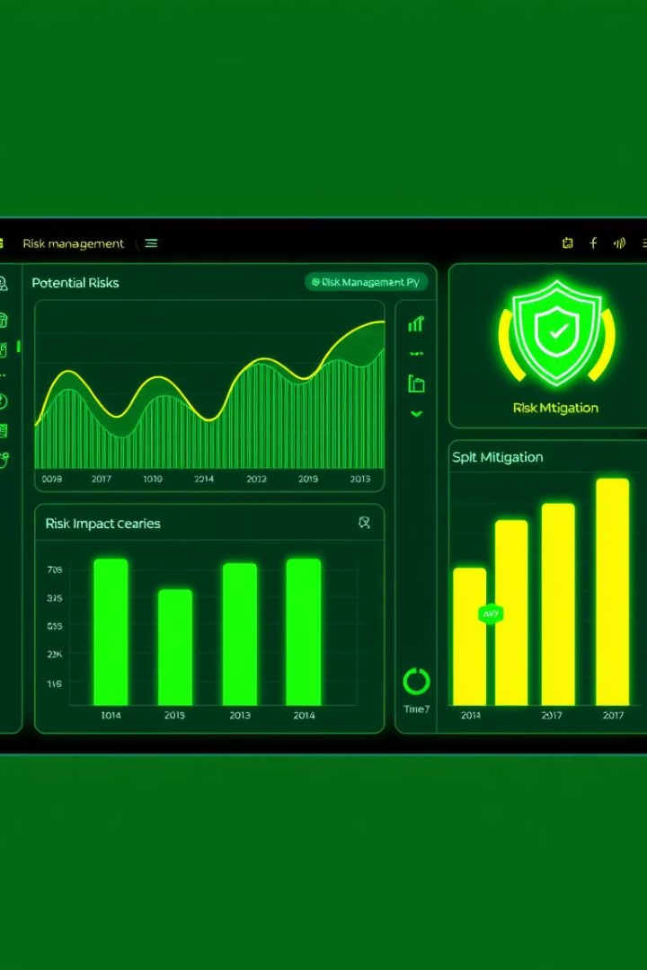
Risk Controls - Gross & Net Exposure
Gross Exposure
Capped at 100% of total capital invested.
Net Exposure
Adjusted toward ±10% to balance longs and shorts.
Controlled Leverage
Ensures exposure stays within predefined risk limits.

Slide 9
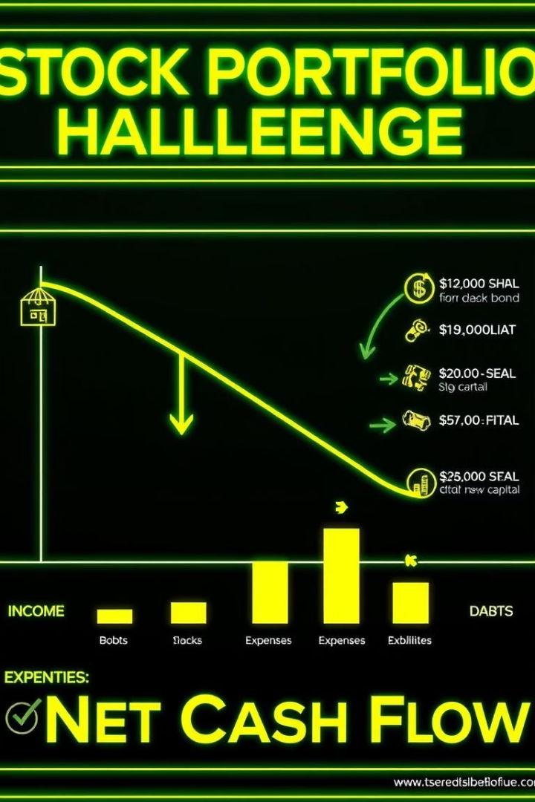
Ensuring Non-negative Cash
Cash Monitoring
Realistic Trading
Sell shares if cash becomes negative to cover shortfall.
Prevents buying beyond available capital.
Final Fallback
Cap purchases to cash on hand at all times.

Slide 10
Strategy Summary
Outputs
Extensions
Portfolio value over time
Supports slippage, transaction costs, and further modeling.
Trade logs and position histories
Allows detailed equity curve and drawdown analysis.
Cash balance records

